Slide 1

VPH-Share Tutorial
Portal Login & Access
Application Development & Deployment

Slide 2



VPH-Share Research Platform
VPH-Share is a 20-Partner FP7 Integrated Project that is constructing an online, cloud-based environment in which users can share software tools, applications and data, and can develop and execute in silico clinical workflows.
Four Flagship Workflows are included as demonstrators and, in recent months a significant number of additional Use Cases have been added to the project, several of which are already active
Operational for over 12 months, with new features and content being added continuously.

Slide 3




Platform Building Blocks
Unified Identity
Security
Workflows
Semantics
High Performance
Applications
Structured Data
Cloud Computing
Unstructured data

Slide 4


VPH-Share - Research Partnerships
Academic Partners
Industrial Partners
Clinical Partners
Third-Party Collaborators
Notes:
Slide Objectives:
Describe our current mix of partners and collaborators
Speaking Points:

Slide 5
Reviewers: Guided Introduction
At the project’s second periodic review in April 2013 the Reviewers proposed that, to obtain an enriched appreciation of the system, they might have access to the infrastructure during the two week period prior to the 3rd Periodic Review. This has been arranged, and VPH-Share accounts have been enabled for each reviewer.
VPH-Share, although carefully designed, is none-the-less a complex infrastructure and, as with all such systems, the full benefits emerge after a degree of familiarisation.
To help with this learning process we have prepared a set of illustrated guidance slide-sets that show users how to begin using the system and carry out three common activities.

Slide 6
For the busy reviewer
In all cases you’ll need to see through the Login process. The three activities are then described in separate tutorials, and each requires around 40 minutes to complete. If time doesn’t permit this degree of engagement, it may be that an agreement between Reviewers to split the three tasks amongst you may be a possible solution.
If this is palatable, the data-centred activities are probably the least challenging (perhaps 4/10), with the application and workflow development activities being the most challenging (perhaps 7/10)
If you’re particularly time-challenged, but would still like to try the system, the Data activity includes as its final step a search exercise to identify semantically-tagged data; this will give a flavour of the system without requiring a large investment of time.

Slide 7
Cloud Application Developer
VPH-Share Cloud Application Developer

Slide 8
Summary
VPH-Share provides for the development and sharing of computational processes that are useful as components of larger workflows (and perhaps also as stand-alone entities). This Application guide covers the creation of a VPH-Share Application built from a pre-existing service.
Become familiar with the process of using VPH-Share Applications
Find an existing Application already available within VPH-Share, note its characteristics
Start an instance of the Application
Identify important information required to make use of this now-running Application
Create a new Application from an existing program (which is provided to you); first, install the program and try it out on your local PC.
Create the VPH-Share Application…
Obtain the necessary confidential ‘Secure Shell’ SSH credentials and uploading them
Choose the basic ‘wrapper’ that will be used to encapsulate the Application
Define the details of the wrapper, including its ‘endpoint’ (the location where the service will become available)
Make the Application available to other users.

Slide 9
Cloud Application Developer
01
Search & Discovery
04
Application Endpoints
02
Cloud Application Instantiation
05
Sharing & Permissions
03
Application Deployment

Slide 10
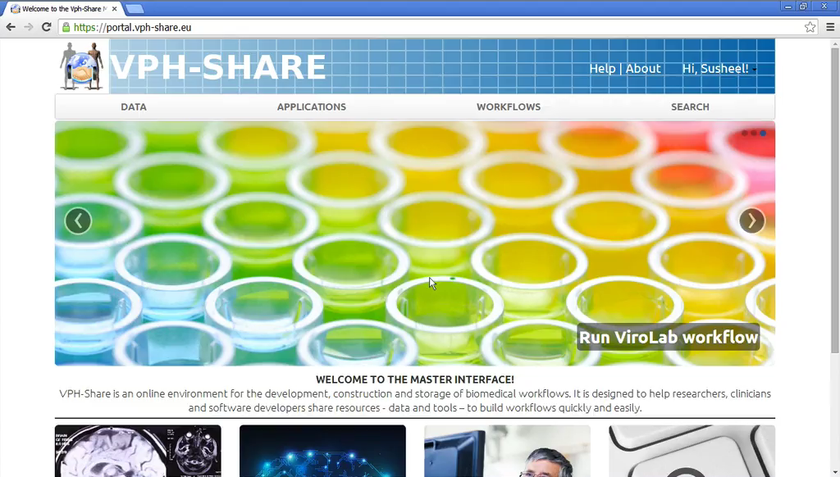
Cloud Application Developer

Slide 11
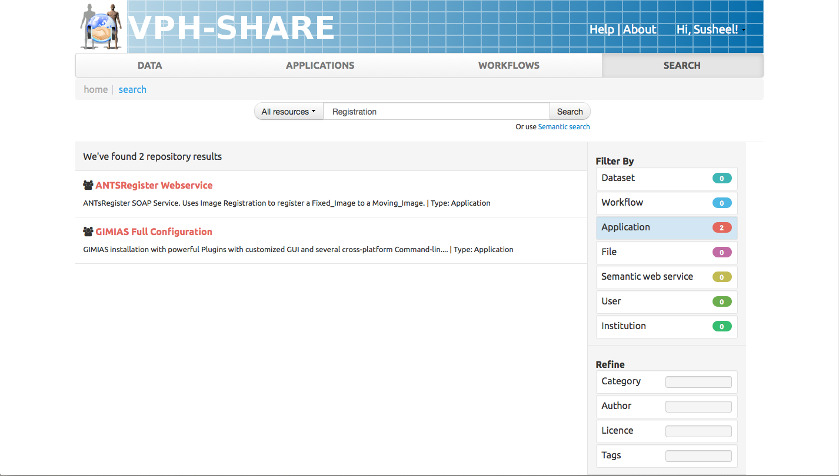
01
Search
& Discovery
Click Search Tab and search for ‘Registration’ and filter by ‘Applications’ to drill-down the results.
Choose the ‘ANTSRegister WebService’
a
b
VPH-Share provides base application templates and pre-configured applications that can be instantiated by user with authorised permissions for use.
Notes:
User Manual (General Search): http://www.vph-share.eu/content/general-search
User Manual (Browse Applications): http://www.vph-share.eu/content/browse-and-search-applications

Slide 12
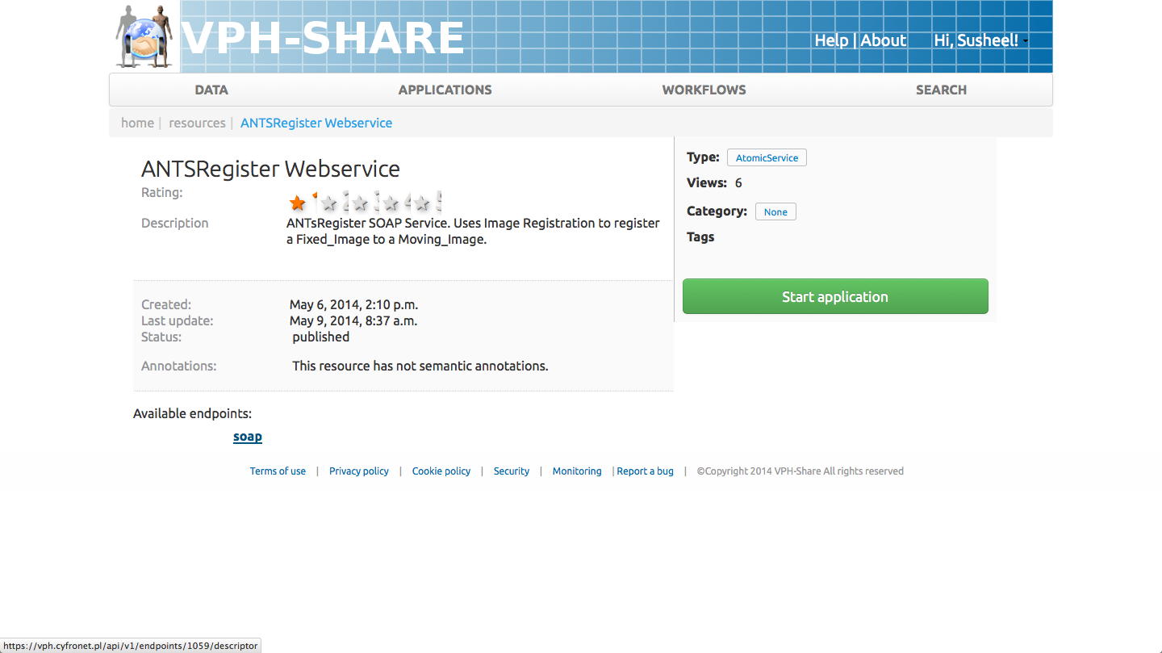
01
Search
& Discovery
Click Search Tab and search for ‘Registration’ and filter by ‘Applications’ to drill-down the results.
Choose the ‘ANTSRegister WebService’
View metadata and available soap endpoint
c
VPH-Share provides base application templates and pre-configured applications that can be instantiated by user with authorised permissions for use.
Notes:
User Manual (General Search): http://www.vph-share.eu/content/general-search
User Manual (Browse Applications): http://www.vph-share.eu/content/browse-and-search-applications

Slide 13
02
Cloud Application Instantiation
Click ‘Start Application’
a
Cloud Applications may be instantiated with different (CPU, RAM, HDD) flavours and different pre-configured configurations in developer mode that allows the application to be configured further
Notes:
User Manual: https://vph.cyfronet.pl/tutorial/doku.php?id=as_instantiation

Slide 14
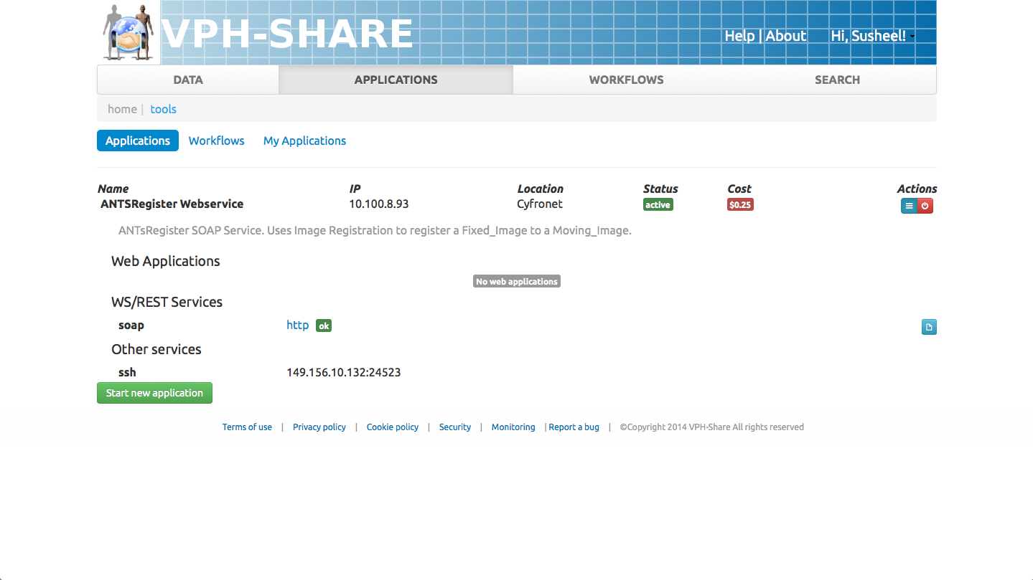
02
Cloud Application Instantiation
Click ‘Start Application’
Wait for the Application to be instantiated and click blue dropdown box
Developers may access exposed WS/REST Services or via SSH
b
c
Cloud Applications may be instantiated with different (CPU, RAM, HDD) flavours and different pre-configured configurations in developer mode that allows the application to be configured further
Notes:
User Manual: https://vph.cyfronet.pl/tutorial/doku.php?id=as_instantiation

Slide 15
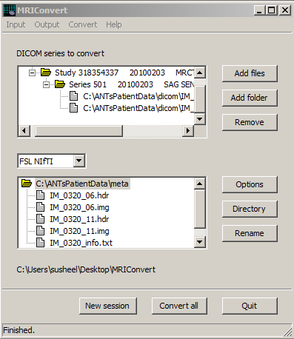
03
Application Deployment
Double-click ‘MRIConvert’ application from ANTsPatientData.zip
Choose ‘Add Files’ in ANTsPatientData > dicom folder
Choose MetaImage and an output directory
b
c
We will be using a simple MRI Image converter application that we will be using to demonstrate how a developer of the application may deploy this application within VPH-Share
Notes:
User Manual: https://vph.cyfronet.pl/tutorial/doku.php?id=as_development

Slide 16
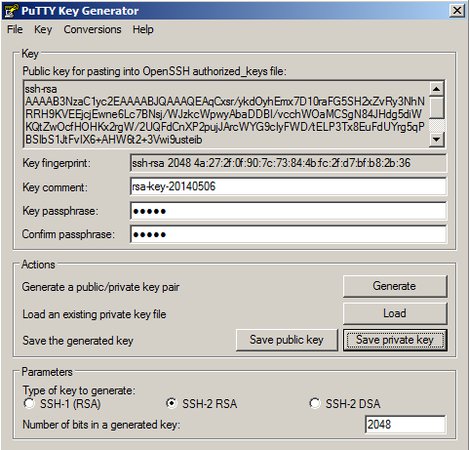
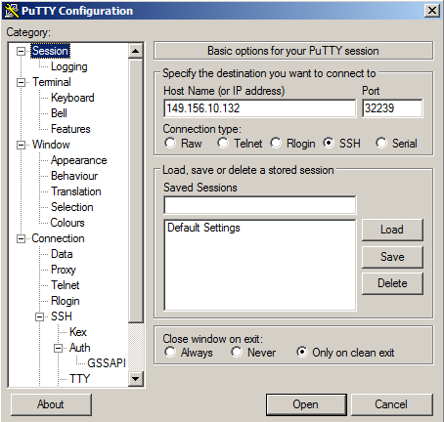
03
Application Deployment
VPH-Share uses public-key cryptographic SSH keys to allow developers low-level access to VPH-Share. To ensure complete security, the user must generate these keys locally and upload to VPH-Share.
Download and Install Putty and PuttyGen (Windows)
Use PuttyGen to generate the SSH private & public keys
b
Developers can obtain deep low-level access to the instantiated Application. For this, user must create an SSH private key and upload their public to VPH-Share
Notes:
User Manual: https://vph.cyfronet.pl/tutorial/doku.php?id=as_development
SSH Keys Generation: On linux, use ssh-keygen See: https://vph.cyfronet.pl/tutorial/doku.php?id=as_development#registering_developer_credentials

Slide 17
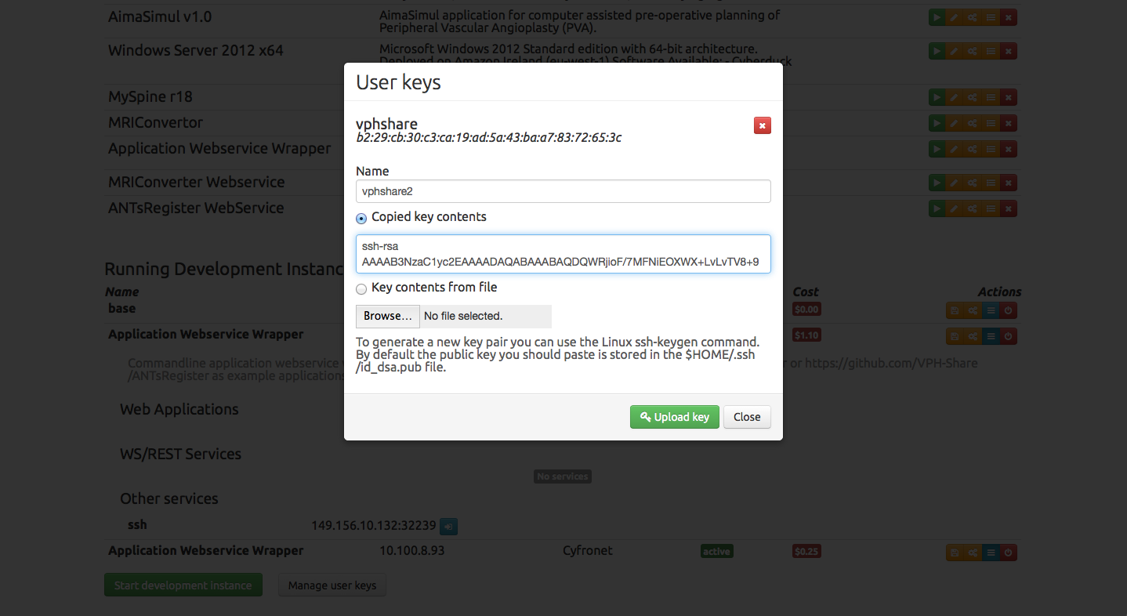
03
Application Deployment
Download and Install Putty and PuttyGen (Windows)
Use PuttyGen to generate the SSH private & public keys
Navigate to Applications > My Applications > Manage Keys
Upload the public key to VPH-Share
d
Developers can obtain low-level access to the instantiated application. For this, the registered user must create an SSH private key and upload their public keys to VPH-Share
Notes:
User Manual: https://vph.cyfronet.pl/tutorial/doku.php?id=as_development
SSH Keys Generation: On linux, use ssh-keygen See: https://vph.cyfronet.pl/tutorial/doku.php?id=as_development#registering_developer_credentials

Slide 18
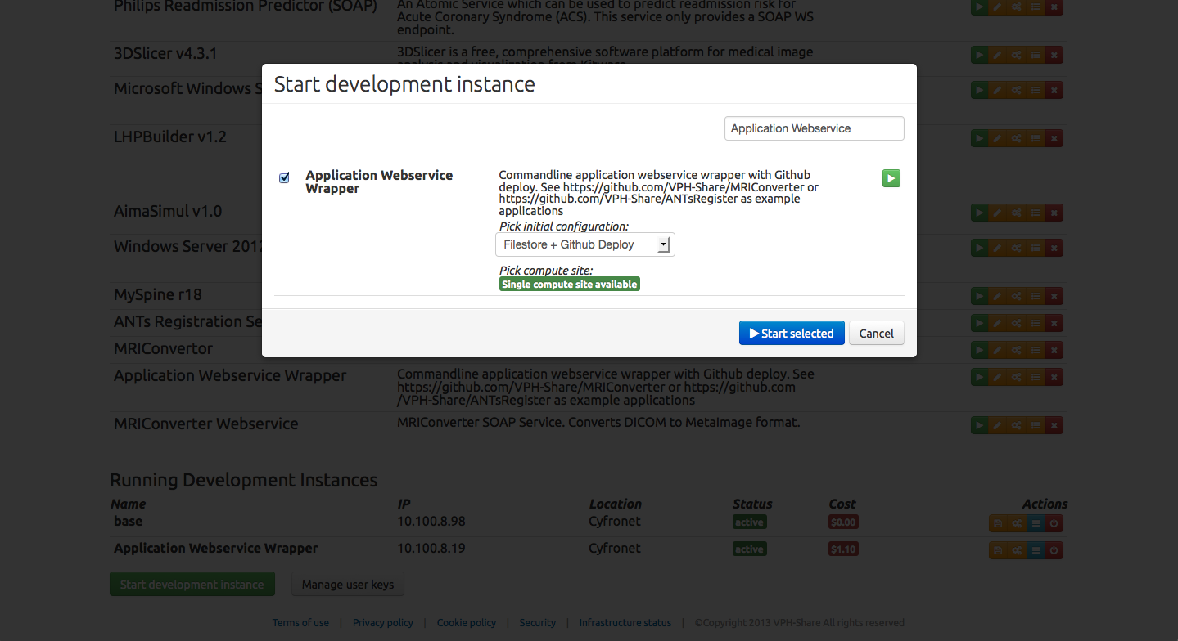
03
Application Deployment
Click Applications > My Applications > Start Development
Filter using ‘Application Webservice Wrapper’
Choose ‘Github Deploy’ configuration and set variable to https://github.com/VPH-Share/MRIConverter
Pick your SSH key and application flavour (CPU, RAM)
b
c
a
VPH-Share allows developers to customise application templates and applications with SSH and/or remote desktop access. Configurations can also be used to deploy your application, simply by providing your Github repository in this example.
Notes:
User Manual: https://vph.cyfronet.pl/tutorial/doku.php?id=as_development
Note: Initial configurations can be used to pass custom data directly to your service instance. Once the service has booted, the initial configuration will be exposed to it under a special URI.

Slide 19
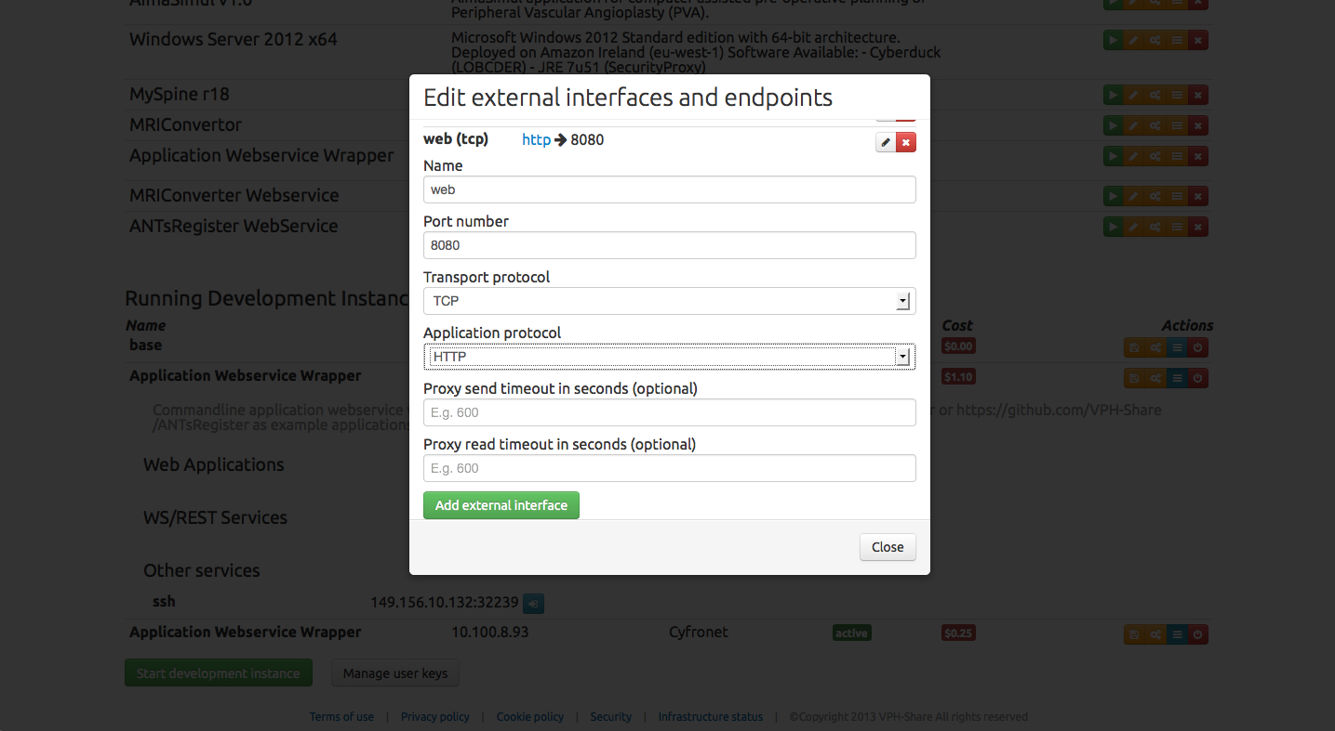
04
Application
Endpoints
Click icon to edit external interfaces
Add the following as a new external interface
name = ‘web’, port = ‘8080’, transport_protocol = ‘TCP’
application_protocol ‘HTTP’
Click Close
b
a
c
Applications that need to be configured to be available via the web need to expose a transport protocol (TCP, UDP) port that will be automatically be redirected by VPH-Share
Notes:
User Manual: https://vph.cyfronet.pl/tutorial/doku.php?id=as_development

Slide 20
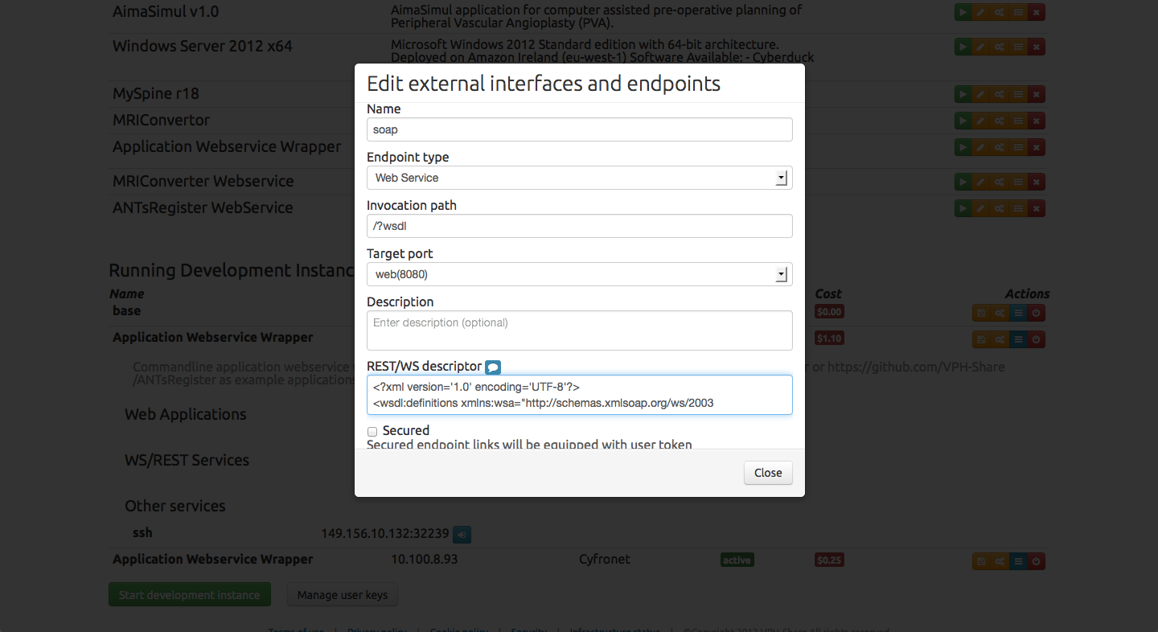
04
Application
Endpoints
Click icon to edit endpoints
Add the following as a new endpoint
name=‘soap’, endpoint=‘webservice’,
invocation_path=‘/?wsdl’, target_port=web(8080),
WS Descriptor -> copy paste the WSDL text (See Note)
b
a
Webservices or web applications that expose an endpoint must also be configured to be made available to other users via the internet.
Notes:
User Manual: https://vph.cyfronet.pl/tutorial/doku.php?id=as_development
REST/WS Descriptor:
<?xml version='1.0' encoding='UTF-8'?>
<wsdl:definitions name="MRIConverter" targetNamespace="mri" xmlns:plink="http://schemas.xmlsoap.org/ws/2003/05/partner-link/" xmlns:s1="MRIConverter" xmlns:s12enc="http://www.w3.org/2003/05/soap-encoding/" xmlns:s12env="http://www.w3.org/2003/05/soap-envelope/" xmlns:senc="http://schemas.xmlsoap.org/soap/encoding/" xmlns:senv="http://schemas.xmlsoap.org/soap/envelope/" xmlns:soap="http://schemas.xmlsoap.org/wsdl/soap/" xmlns:tns="mri" xmlns:wsa="http://schemas.xmlsoap.org/ws/2003/03/addressing" xmlns:wsdl="http://schemas.xmlsoap.org/wsdl/" xmlns:xop="http://www.w3.org/2004/08/xop/include" xmlns:xs="http://www.w3.org/2001/XMLSchema" xmlns:xsi="http://www.w3.org/2001/XMLSchema-instance">
<wsdl:types>
<xs:schema elementFormDefault="qualified" targetNamespace="mri">
<xs:import namespace="MRIConverter"/>
<xs:import namespace="http://www.w3.org/2001/XMLSchema"/>
<xs:complexType name="convert">
<xs:sequence>
<xs:element minOccurs="0" name="img_format" nillable="true" type="xs:string"/>
<xs:element minOccurs="0" name="inputPath" nillable="true" type="xs:string"/>
<xs:element minOccurs="0" name="outputPath" nillable="true" type="xs:string"/>
</xs:sequence>
</xs:complexType>
<xs:complexType name="convertResponse">
<xs:sequence>
<xs:element minOccurs="0" name="convertResult" nillable="true" type="s1:ConvertorResponse"/>
</xs:sequence>
</xs:complexType>
<xs:element name="convert" type="tns:convert"/>
<xs:element name="convertResponse" type="tns:convertResponse"/>
</xs:schema>
<xs:schema elementFormDefault="qualified" targetNamespace="MRIConverter">
<xs:import namespace="http://www.w3.org/2001/XMLSchema"/>
<xs:complexType name="ConvertorResponse">
<xs:sequence>
<xs:element minOccurs="0" name="stdout" nillable="true" type="xs:string"/>
<xs:element minOccurs="0" name="cwd" nillable="true" type="xs:string"/>
<xs:element minOccurs="0" name="outputPath" nillable="true" type="xs:string"/>
<xs:element minOccurs="0" name="command" nillable="true" type="xs:string"/>
<xs:element minOccurs="0" name="stderr" nillable="true" type="xs:string"/>
<xs:element minOccurs="0" name="statuscode" nillable="true" type="xs:integer"/>
</xs:sequence>
</xs:complexType>
<xs:element name="ConvertorResponse" type="s1:ConvertorResponse"/>
</xs:schema>
</wsdl:types>
<wsdl:message name="convert">
<wsdl:part element="tns:convert" name="convert"/>
</wsdl:message>
<wsdl:message name="convertResponse">
<wsdl:part element="tns:convertResponse" name="convertResponse"/>
</wsdl:message>
<wsdl:portType name="MRIConverter">
<wsdl:operation name="convert" parameterOrder="convert">
<wsdl:input message="tns:convert" name="convert"/>
<wsdl:output message="tns:convertResponse" name="convertResponse"/>
</wsdl:operation>
</wsdl:portType>
<wsdl:binding name="MRIConverter" type="tns:MRIConverter">
<soap:binding style="document" transport="http://schemas.xmlsoap.org/soap/http"/>
<wsdl:operation name="convert">
<soap:operation soapAction="convert" style="document"/>
<wsdl:input name="convert">
<soap:body use="literal"/>
</wsdl:input>
<wsdl:output name="convertResponse">
<soap:body use="literal"/>
</wsdl:output>
</wsdl:operation>
</wsdl:binding>
<wsdl:service name="MRIConverter">
<wsdl:port binding="tns:MRIConverter" name="MRIConverter">
<soap:address location="#{descriptor_url}"/>
</wsdl:port>
</wsdl:service>
</wsdl:definitions>

Slide 21
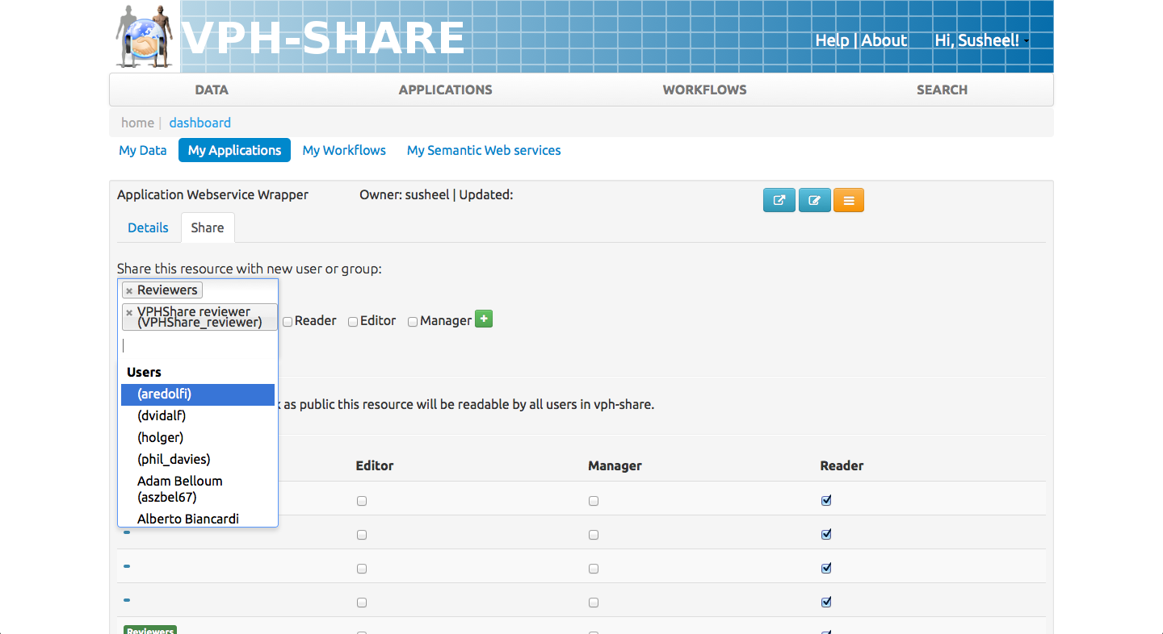
05
Sharing
& Permissions
Click on your NAME > Dashboard > My Applications
Select your Application > > Share Tab
Search for individual or Group
Choose permission ‘Editor’ and click the plus sign
a
b
c
d
VPH-Share allows fine-grained permissions on all resources. Sharing may be performed on individuals and/or groups according to the needs of the resource owner.
Notes:
User Manual: http://www.vph-share.eu/content/grant-permissions
User Manual: https://vph.cyfronet.pl/tutorial/doku.php?id=as_development#sharing_your_service_with_other_users

Slide 22
GLOSSARY
API – Application Programming Interface
Webservice – A method of communication between two electronic addresses on the Internet. Typically between a client and a server
SOAP – Type of webservice communication protocol
REST – Type of webservice communication protocol
SSH – Secure Shell. Method of access to a remote server
MetaImage – Type of image format specification
WSDL – SOAP webservice definition language

Slide 23
Notes:
Slide Objectives:
Speaking Points:

Slide 24
Notes:
Slide Objectives:
Speaking Points:

